Slide 1
Toronto Major Crime Insights
Tina Faraji
Vanshika Sapra
Zoë Levings
Yu-Chieh Lin
Notes:
Hi everyone, today our group will be presenting our insights from our analysis of crime in Toronto.

Slide 2
Table of contents
01
Executive Summary
05
Modeling Approach
02
Business Problem
06
Results & Interpretation
03
Data & Preprocessing
07
Ethics & Limitations
04
Feature Engineering
08
Recommendations & Implications
Notes:
Here is a quick overview of what we will be covering today

Slide 3
Executive Summary
01
Notes:
Starting off with the executive summary

Slide 4

Our project looks at when and where crimes happen in Toronto to understand crime to help with prevention, not just reaction.
Analyze crime patterns by time (temporal) and by neighborhood and location (spatial).
Notes:
We approached the problem by analyzing patterns over time, including time of day, day of week, and month, along with geographic differences between neighborhoods.
These insights can help police departments allocate patrols more efficiently and help social programs focus support where communities need it most.

Slide 5
02
Business Problem
Notes:
So for the business problem

Slide 6
2M
5%
Police reported Criminal Code incidents
Key Indicators
Increase in violent crime rate
Source: Statistics Canada
Notes:
Before diving into the analysis, here are two numbers that emphasize the importance of this issue. First, Statistics Canada recorded about 2 million Criminal Code incidents in toronto which highlights the scale of law-enforcement demand. Second, violent crime has increased by roughly 5 percent in the city, showing that the problem is not static, it is indeed growing. These indicators emphasize why understanding crime patterns is so critical.

Slide 7
Problem Description
Issue: Crime prevention strategies are often not proactive enough
Challenge: Figuring when and where the crime is more likely to occur, so resources can be used effectively
Goal: Use data to uncover patterns that guide smarter patrol planning and help social services target support where it is most needed
Notes:
The core issue is that crime prevention strategies are often reactive rather than proactive. Police respond after incidents occur, instead of anticipating when and where they might happen. The challenge then is identifying the conditions and patterns that make crime more likely, so resources can be targeted before crime occurs.
Our goal is to use data to uncover those patterns and support smarter patrol planning, better community intervention, and more efficient allocation of city resources.

Slide 8
03
Data & Preprocessing

Slide 9
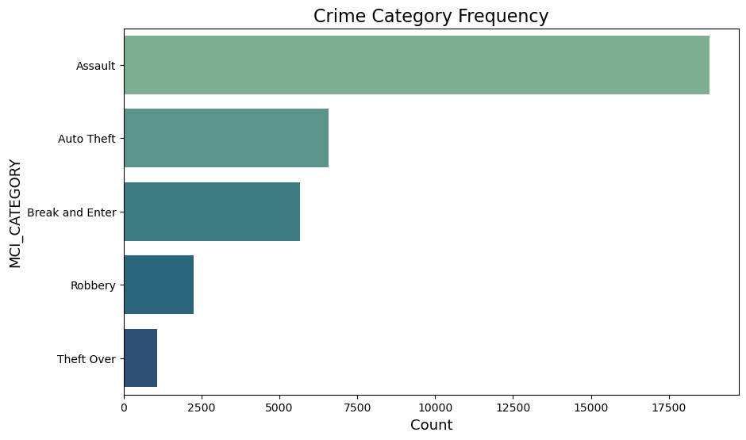
Crimes Dataset
Types of crimes

Slide 10
Neighborhood Dataset
Population size
Age
Income data (household, average, GINI)
Housing (need, shelter cost, suitability)
Employment (workforce participation, unemployment)
Education (high school, postsecondary)

Slide 11
Cleaning/ preprocessing
Crimes
Rename columns
Delete null neighborhoods
Rename columns
Check multicollinearity: income and education
Neighborhoods

Slide 12
Feature Engineering
04

Slide 13
Feature Engineering
Group By Neighborhood
Calculate Stats
Merge Datasets
T- Fix Orientation
Switch characteristics to columns and neighborhoods to rows
Group to get crime count in each neighborhood
Crime and characteristics in one set
Get crime count by population then extract 'risk' through min max

Slide 14
05
Modeling Approach

Slide 15
Modeling Approach & Rationale
Linear Regression
Classification
Clustering
Purpose: Identity which neighborhood characteristics are most strongly associated with higher crime risk
Limit: Low score consistency, number of neighborhoods
Purpose: Predict categorical outcomes related to crime
Purpose: Group neighborhoods based on shared characteristics

Slide 16
06
Results & Interpretations

Slide 17
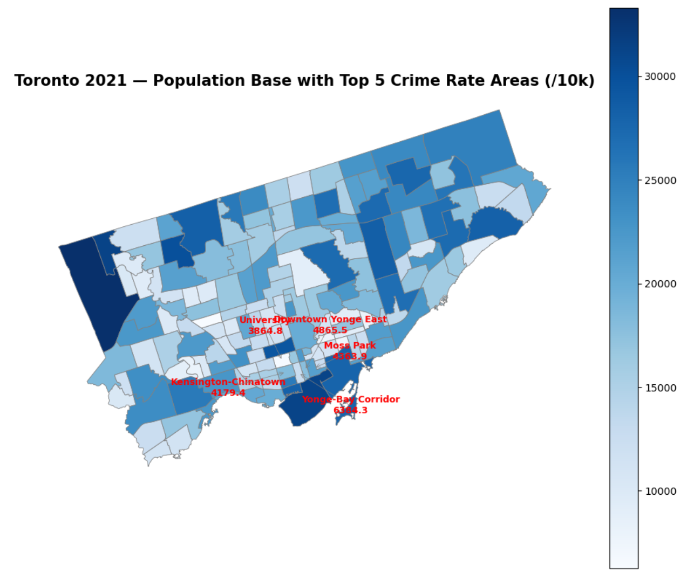
Population and Crime Rate
Crime Rate =
(Number of Crimes / Population) × 10,000
Dark color: dense population
Light color: sparse population
Low relationship between population and crime rate
Crime rate is concentrated in urban areas

Slide 18
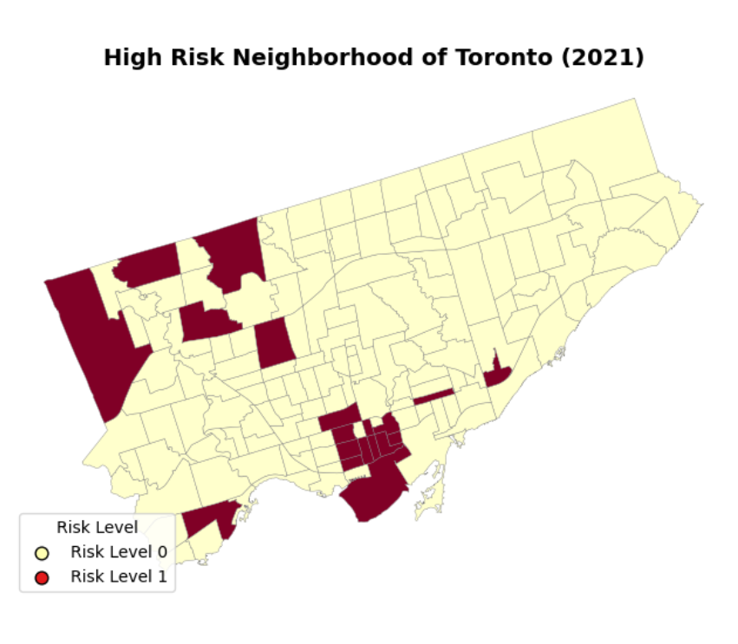
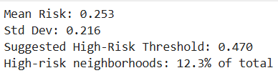
High / Low Risk
Risk = Crime Rate with MinMaxScaler
Threshold = 0.3
Risk > 0.3 = High
Risk < 0.3 = Low

Slide 19
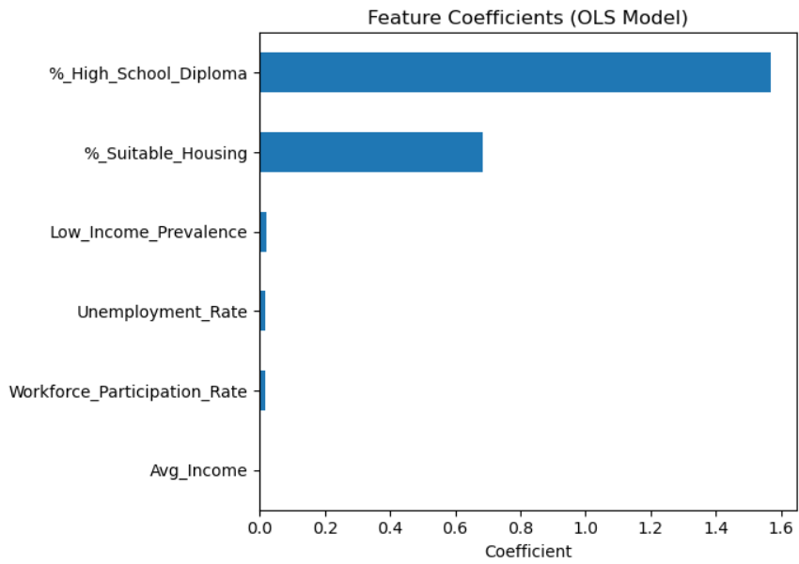
Which neighborhood characteristics point towards risk?
High School Diploma
Strong predictor
Suitable Housing
Strong predictor
Low Income Prevalence
Weak predictor
Workforce Participation Rate
Weak predictor
Unemployment Rate
Weak predictor
Average Income
No coefficient strength

Slide 20
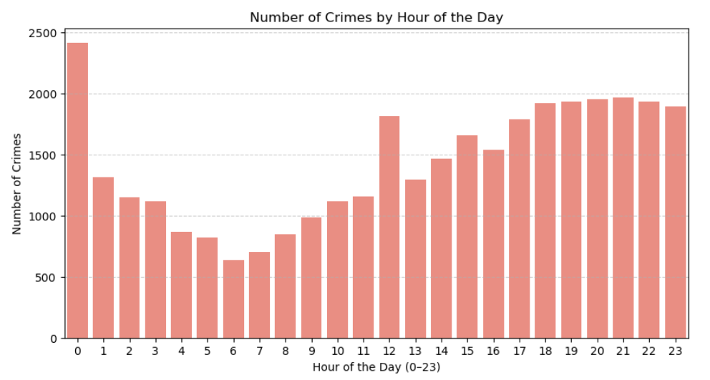
Classification Model 1 – Day & Night
Crime is highest late at night, lowest in the early morning, and climbs again in the evening.

Slide 21
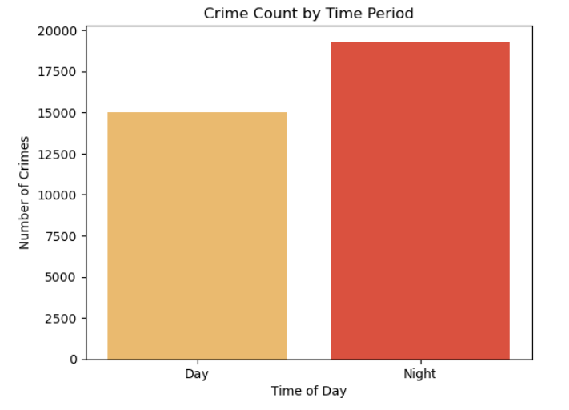
Classification Model 1 – Day & Night
Day: 6 A.M. to 6 P.M.
Night: 6 P.M. to 6 A.M.
Data imbalanced

Slide 22
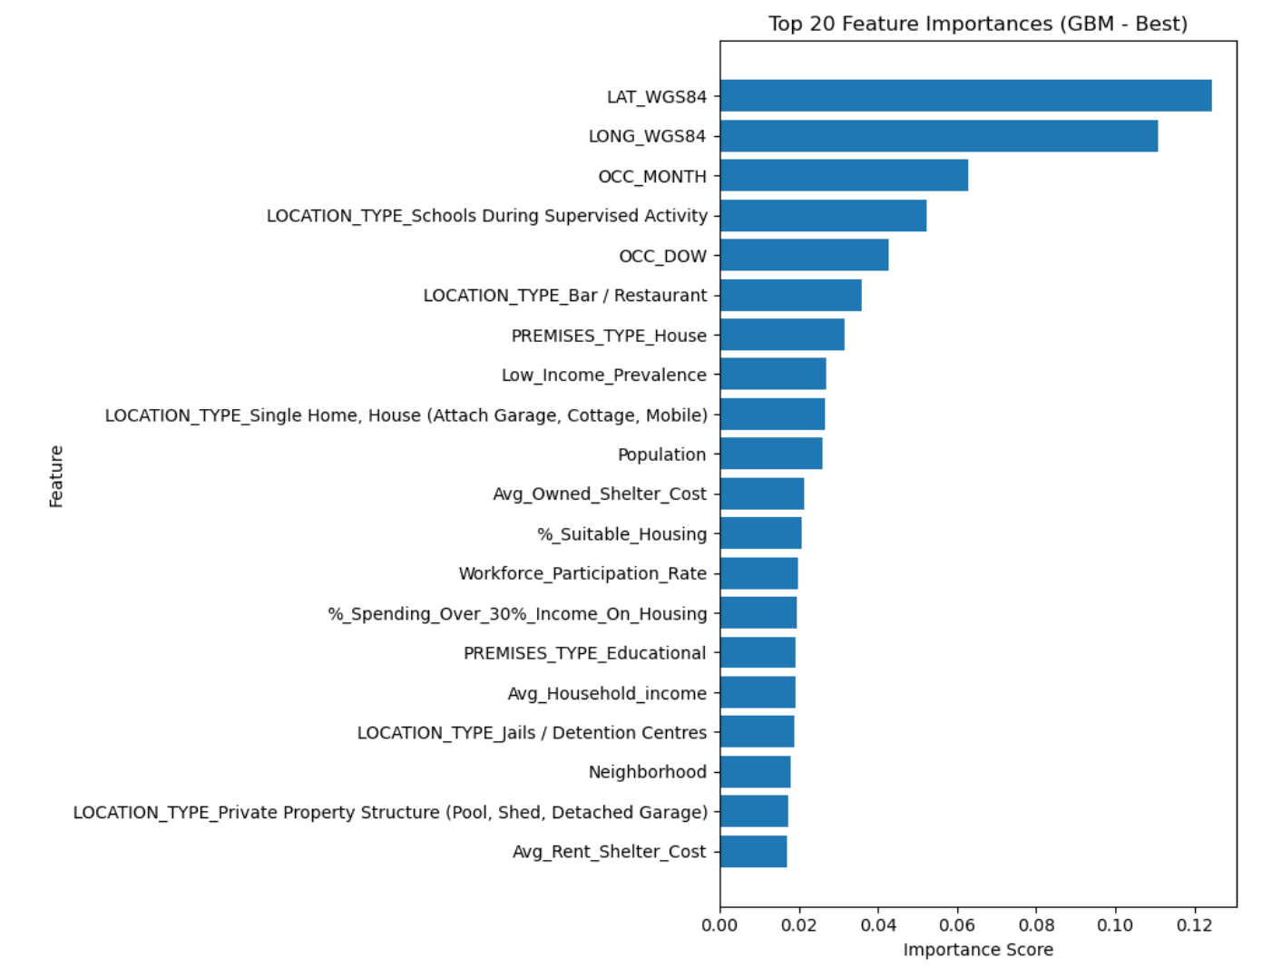
Classification Model 1 – Day & Night
Model | Test Accuracy | AUC
Logistic Regression (Baseline) | 0.541 | 0.577
Fine-tuned RF | 0.572 | 0.616
Fine-tuned GBM | 0.579 | 0.591
Identify consistent risk factors: location, month, and socioeconomic characteristics, which can support data-driven policing and resource allocation.

Slide 23
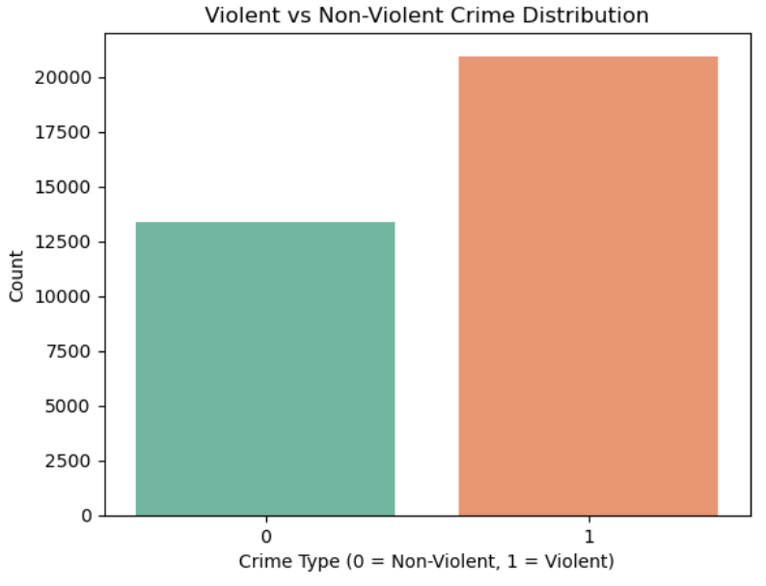
Classification Model 2 – Violent / Non Violent
Define the violent words: "Assault, Bodily Harm, Firearm, Weapon, Robbery, Threat".
If yes =1, no =0
More violent crime in 2021

Slide 24
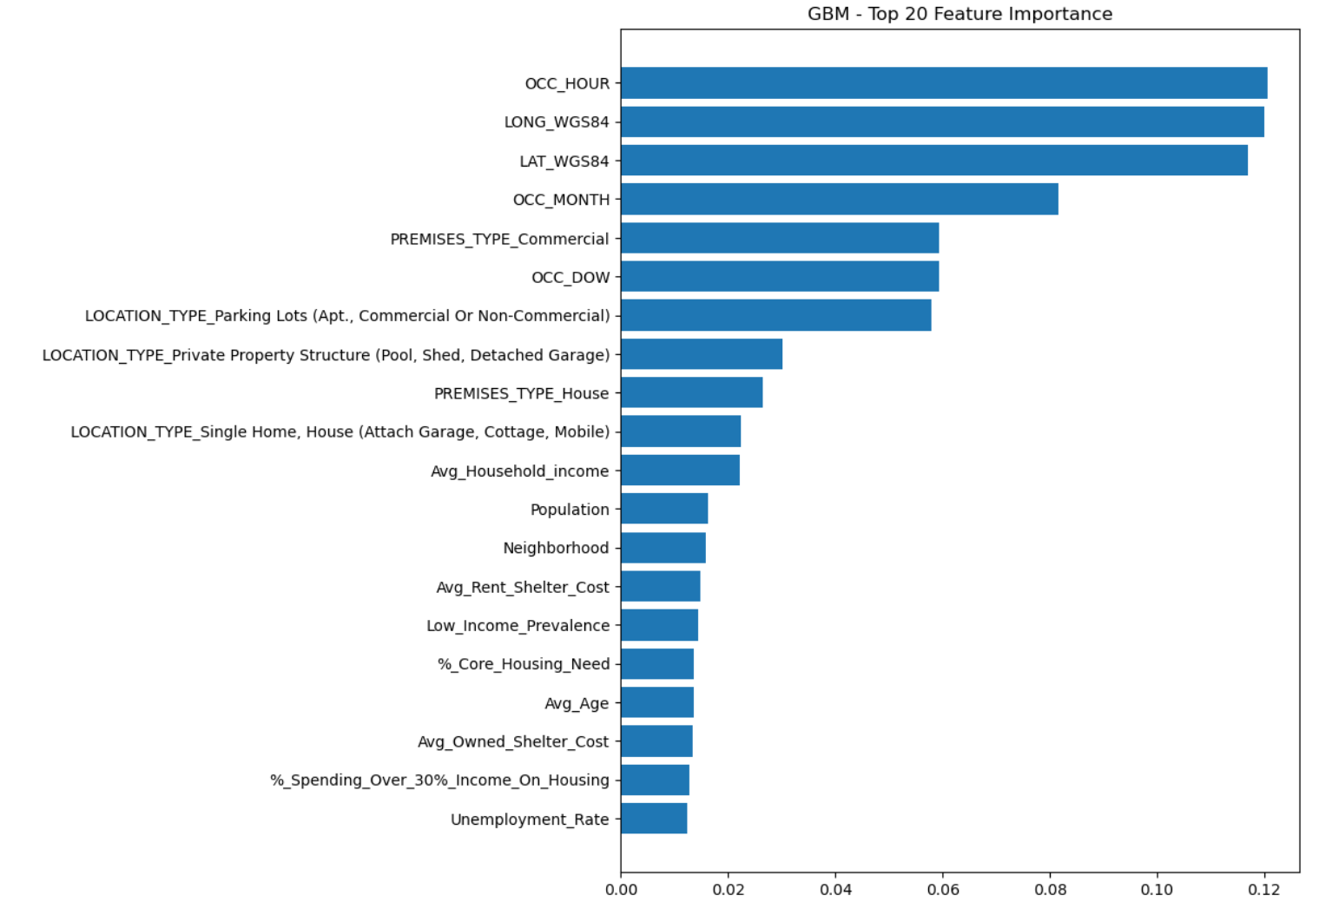
Classification Model 2 – Violent / Non Violent
Model | Test Accuracy | AUC
Logistic Regression (Baseline) | 0.584 | 0.628
Fine-tuned RF | 0.738 | 0.801
Fine-tuned GBM | 0.766 | 0.821
Violent crime is primarily influenced by timing and location, which are the strongest predictors in the model.

Slide 25
Two Dimensional Analysis
Grouped neighborhoods by which crimes occur most frequently
Grouped neighborhoods by demographic characteristics
Crime Cluster 0: Theft Dominant
Crime Cluster 1: Assault Dominant
Crime Cluster 2: Break & Enter Dominant
Crime Cluster 3: Auto Theft Dominant
Socio 0: Young, Educated & Low Income
Socio 1: Balanced / Middle-Income
Socio 2: Affluent & High Inequality
Socio 3: Lower Education & High Unemployment
How do these two clusterings overlap?
Do certain socioeconomic types align with specific crime patterns?

Slide 26
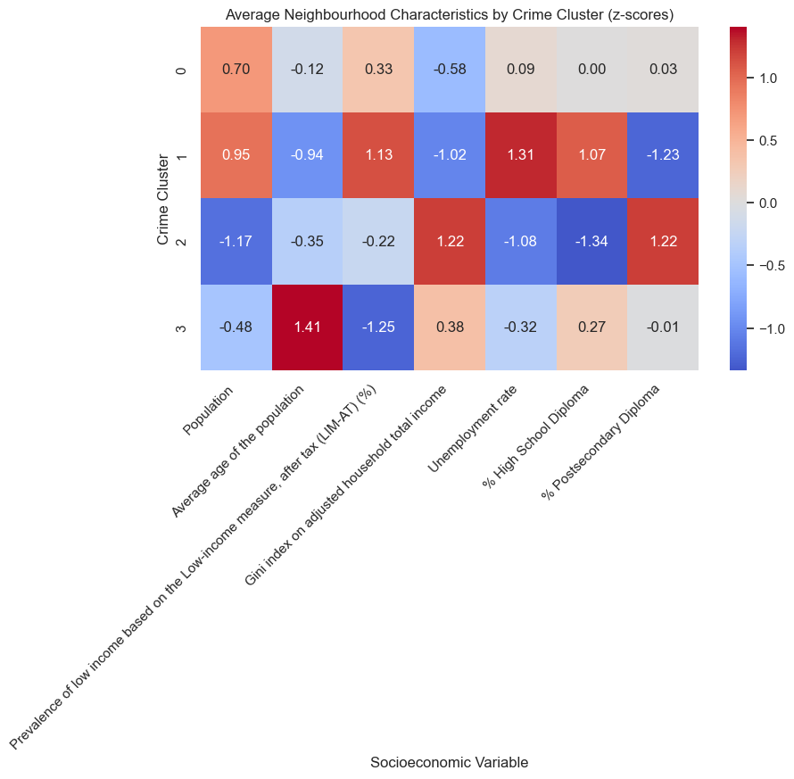
K-Means Clustering
Heatmap
Larger, younger areas with lower ineqaulity and average unemployment and education
Likely to be commercial/retail zones
Cluster 0: Theft Over
Younger, higher low-income prevalance, highest unemployment, lower post-secondary education but only high school is higher.
Strong link to social stressors and inequality (vulnerable communities)
Cluster 1: Assault
Cluster 2: Break & Enter
Smaller, younger areas with higher inequality, lower unemployment rate but mixed education level, indicating transitional neighbourhood
Older, economically stable neighbourhoods with low poverty and unemployment. Likely have vehicles, making a target for vehicle related crimes
Cluster 3: Auto Theft

Slide 27
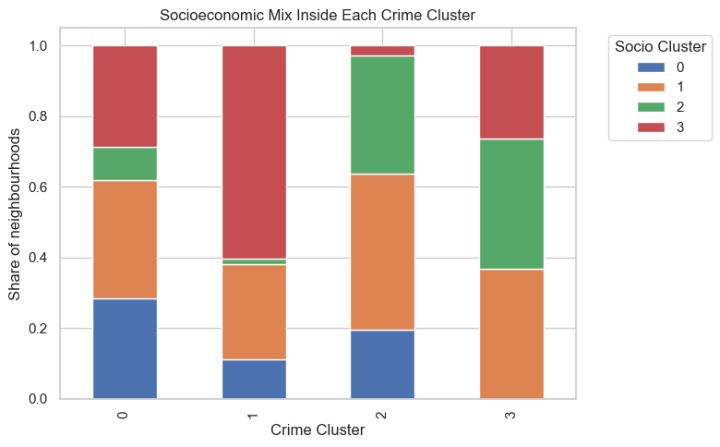
K-Means Clustering
Stacked Bar Chart
Occurs in dense, younger, commercial zones → invest in lighting, CCTV, and CPTED design
Cluster 0
Theft Over
Assault
Break & Enter
Auto Theft
Direct relationship between economic stress and violent crimes → community programs & employment initiatives are important
Cluster 1
0: Young, Educated & Low Income
1: Balanced / Middle-Income
2: Affluent & High Inequality
3: Lower Education & High Unemployment
Cluster 2
Break & Enter happens in where there are valuable targets → focus on target hardening and neighbourhood watch
Cluster 3
Theft follows a similar pattern → better locks and security system

Slide 28
Ethics & Limitations
07

Slide 29
Ethical Considerations & Limitations
Dataset only includes reported crimes, so some areas might seem safer just because of under reporting
Crime patterns can change over time, so this is just a snapshot
Variables are limited. Demographic and other social factors are excluded
Can't find the info about police resource allocation. This analysis can only identify which areas may require increased police presence
Confirmation bias; interpreting data based on existing hypothesis, especially for clusters
Notes:
*add confirmation bias

Slide 30
08
Recommendations & Implications

Slide 31
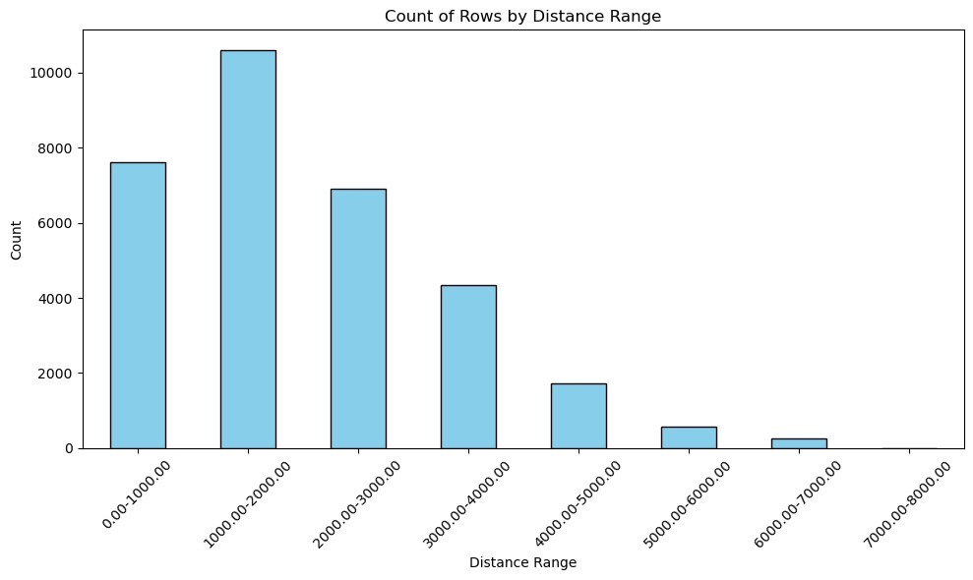
Recommendations
Patrol Optimization
Direct more police allocation toward high-activity areas during the times when crime is most likely to occur (night vs day, violent vs non-violent)

Slide 32
Recommendations
Policy Insight - Crime
Preventive Awareness - Neighborhoods
Share findings with city planners and public safety teams to inform urban decision, such as lighting, transit access, or surveillance placement
Use findings to support public education and outreach in higher risk areas
Notes:
Get surveys from social

Slide 33
Thank you!

